Slide 1
“25 ways to start an event in Spanish”
DEPARTMENT OF LINGUISTICS
RESEARCH GROUP: GLIMS
The productivity of the inchoative construction
Sven Van Hulle
Renata Enghels
Sven.VanHulle@ugent.be
Renata.Enghels@ugent.be

Slide 2
0. Revision of the concept of productivity
1. Introduction: The inchoative construction in Spanish
2. Research Questions
3. Methodology
4. Cleaning Process
5. Data Exploration
6. Hierarchical Cluster Analysis
7. Near Future

Slide 3
Productivity (BarĐdal 2008)
“Syntactic productivity is a function of a construction’s type frequency, semantic coherence and an inverse correlation between the two.”
Type frequency: “the total number of types which can instantiate a construction”
Token frequency: “the total occurrences of either one or all the types of a construction in a text or corpus”
Semantic coherence: “the semantic consistency between the members of the construction”
Notes:
Sven
Voorbeeld: 700 werkwoorden in het Ijslands met datiefonderwerpen
Citaten: zie pagina 24 en 27 in Barddal 2008

Slide 4
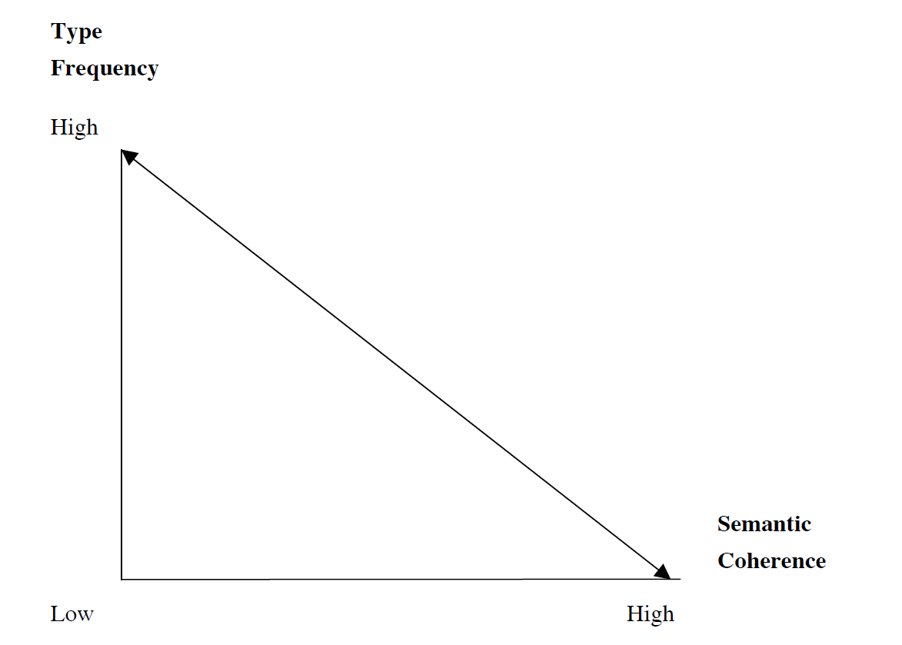
Productivity (BarĐdal 2008)
Notes:
Sven

Slide 5
0. Revision of the concept of productivity
1. Introduction: The inchoative construction in Spanish
2. Research Questions
3. Methodology
4. Cleaning Process
5. Data Exploration
6. Hierarchical Cluster Analysis
7. Near Future

Slide 6
1. The inchoative construction in Spanish
Juan empieza a trabajar (‘John starts to work’)
[Sub] [AUX] [a] [INF]
Pedro se pone a estudiar María rompe a llorar Javier se echa a reír
‘Peter puts himself to study’ ‘Maria breaks to cry’ ‘Javier throws himself to laugh’
4 slots: Subject, Auxiliary, Preposition, Infinitive (Filler)
(se)
Auxiliary: grammaticalized V ?
Inherent inchoative verbs (comenzar, empezar, iniciar, principiar)
Put verbs (ponerse, meterse), change of state verbs (romper), motion verbs (echar), …

Slide 7
2. Research questions
Properties of the inchoative construction
Auxiliaries?
Semantic differences and correspondences between the different subconstructions (i.e. the question of near-synonymy)?
Which semantic classes allowed in INF-slot?
Diachronic part
Is the construction productive? And how productive?

Slide 8
3. Methodology (1)
Research Question: How productive is the auxiliary slot?
Point of departure: 10 ‘established’ inchoative auxiliaries
(arrancar, comenzar, echar, empezar, explotar, liar, meter, poner, romper, soltar)
Exhaustive near-synonymy study in Sketchengine
(based on 3 dictionaries : RAE, Thesaurus and Van Dale)
Result: 15 new auxiliaries, 25 in total

Slide 9
3. Methodology (2)
Empirical study of contemporary peninsular Spanish
Corpus: Sketchengine (EsTenTen18)
PoS-tagged
High Token Frequency (20 billion words)
Web Data
Data Retrieval
1. Download randomized sample of 10.000 tokens
2. Cleaning (and annotating) up to 500 true positives
3. Merging in R

Slide 10
0. Revision of the concept of productivity
1.Introduction: The inchoative construction in Spanish
2. Research Questions
3. Methodology
4. Cleaning Process
5. Data Exploration
6. Hierarchical Cluster Analysis
7. Near Future

Slide 11
4. Cleaning Process
Eliminating ‘false positives’
Tagging errors (Superman, Irán, Pokemon, … as infinitives)
- Auxiliaries with a different meaning (other than inchoative)
2. Selecting the first 500 ‘true positives’
3. Annotation of subject, person, tense, presence of adverbs,…

Slide 12
Cleaning process (1)
A partir de ese momento comenzaron a recibir amenazas de muerte
por teléfono.
“From this moment they started to receive threats of death by telephone”
Después de los tratamientos, el pelo empezaba a crecer.
“After the treatments, the hair started to grow”
Esa historia me fascinó de tal manera que me puse a investigar.
“This story fascinated me to that extent that I started to investigate”
Los nuestros se pusieron a verlas venir.
“Ours put themselves (there) to see them coming.”

Slide 13
Cleaning process (2)
Todos hemos roto a aplaudir.
“We all have started to applaud”.
Su envase es muy original y evita que se rompa a ser de metal.
“Their packaging is very original and avoids that it breaks because it is of metal.”
Me zambullí a leerlo.
“I started to read it.” (“I dove into reading it”)
Me zambullí a echar un vistazo a la concha.
“I dived to take a look at the shell.”
Los marinos se zambulleron a cazar activamente peces.
“The seamen dived to hunt for fish actively.”

Slide 14
Cleaning process (3)
Nos embarcamos a París.
“We embark(ed) for Paris”.
El Estado no puede embarcarse a ayudar a todos los americanos.
“The State cannot start to help all the Americans.”
Se embarca a estudiar en Europa.
“He / She starts to study in Europa.”
Nos embarcamos a hacer una pequeña gira de un mes en Argentina.
“We embark to make a small tour of one month in Argentina.”
Nos embarcamos a descubrir un destino turistico internacional.
“We embark / start (?) to discover an international tourist destination.”

Slide 15
0. Revision of the concept of productivity
1. Introduction: The inchoative construction in Spanish
2. Research Questions
3. Methodology
4. Cleaning Process
5. Data Exploration
6. Hierarchical Cluster Analysis
7. Near Future

Slide 16
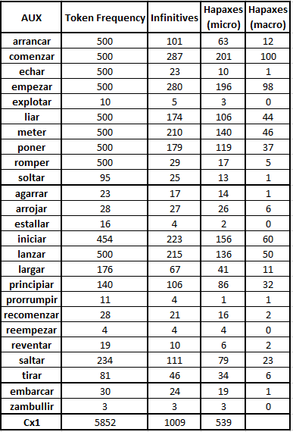
5. data exploration (1)

Slide 17
5. data exploration (2)

Slide 18
5. data exploration (3)

Slide 19
5. data exploration (4)

Slide 20
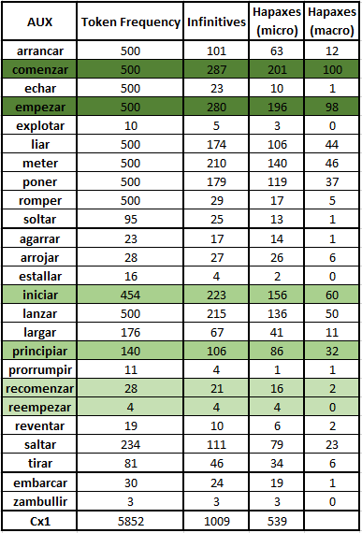
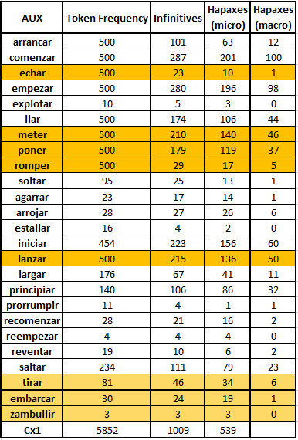
5. data exploration (5)

Slide 21
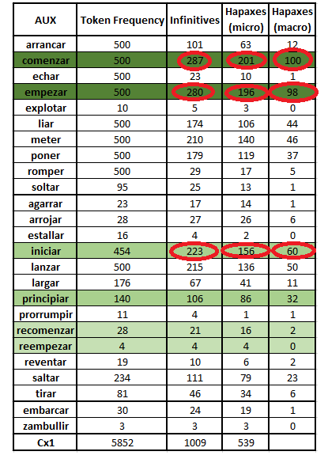
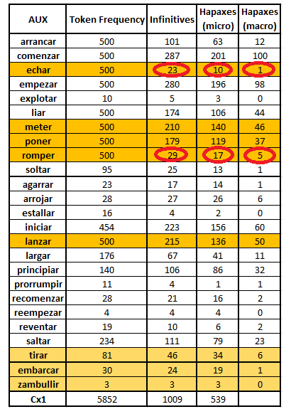
5. data exploration (6)

Slide 22
5. Hapaxes: Micro VS Macro - level
1) Hapaxes: Micro-level
La gente echa a conocer este hermoso pedazo del mundo.
“People start to know this beautiful piece of the world.”
Durante la semana santa comienzan a conocer algunos datos turísticos en España.
“During the ‘semana santa’ they start to know some touristic information in Spain.”
Más adelante se embarca a conocer diferentes proyectos en otras ciudades como Madrid.
“Later on he/she started to know different projects in other cities, like Madrid.”
Los usuarios empiezan a conocer el mundo de la informática.
“The users start to know the world of informatics / computer science.”
El perro se echó a gemir, pero no se escondió.
“The dog started to groan, but he did not hide.”
2) Hapaxes: Macro-level
Infinitive | Token Frequency | How many auxilaries? | Which auxiliaries?
conocer | 18 | 7 | comenzar, echar, empezar, embarcar iniciar, largar, principiar,
gemir | 1 | 1 | echar

Slide 23
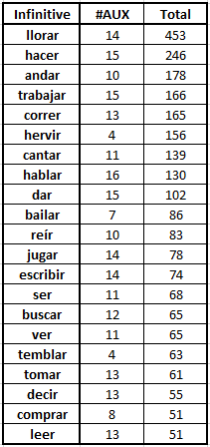
What about the productivity of the fillers? (1)
Mi mama se echó a llorar.
“My mother started to cry.”
Ella se arranca a hacer un playback de la canción.
“She starts to do a playback of the song.”
El Festival de Sarajevo echó a andar en 1995.
“The Festival of Sarajevo started to take place in 1995.”
Comienza a trabajar en la firma “Stone & Webster”.
He / She starts to work in the firm “Stone&Webster”.
Salgo a la calle y empiezo a correr.
“I go out to the street and I start to run.”

Slide 24
What about the productivity of the fillers? (2)

Slide 25
What about the productivity of the fillers? (3)

Slide 26
0. Revision of the concept of productivity
1. Introduction: The inchoative construction in Spanish
2. Research Questions
3. Methodology
4. Cleaning Process
5. Data Exploration
6. Hierarchical Cluster Analysis
7. Near Future

Slide 27
6. Hierarchical Cluster Analysis (1)
Clustering based on lexical similarity of the infinitive-slot
“you know a word by the company it keeps” (Firth 1957)
Assumption: the expressed event is an indication for the semantics of the auxiliary
How near-synonymous are the different auxiliaries?

Slide 28
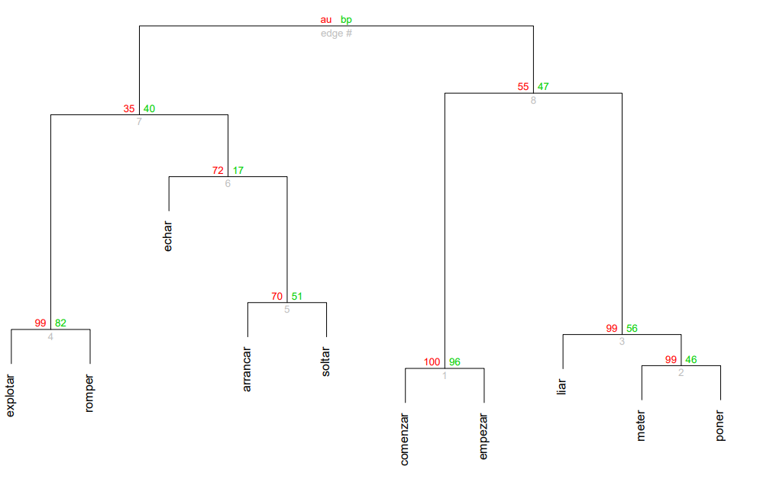
6. Hierarchical Cluster Analysis (2)
approximate unbiased p-values
bootstrap p-values

Slide 29
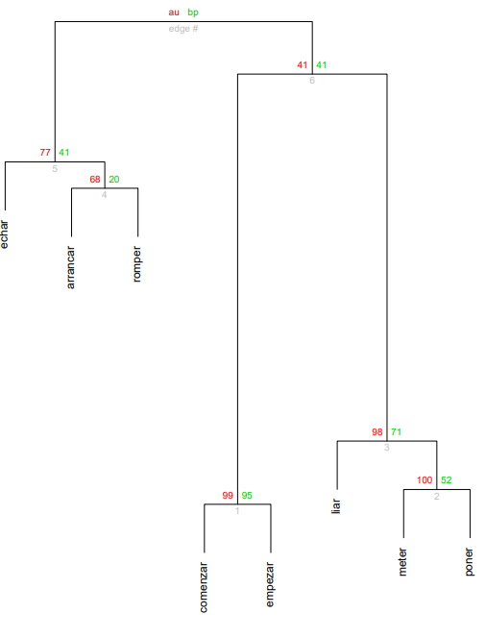
6. Hierarchical Cluster Analysis (3)

Slide 30
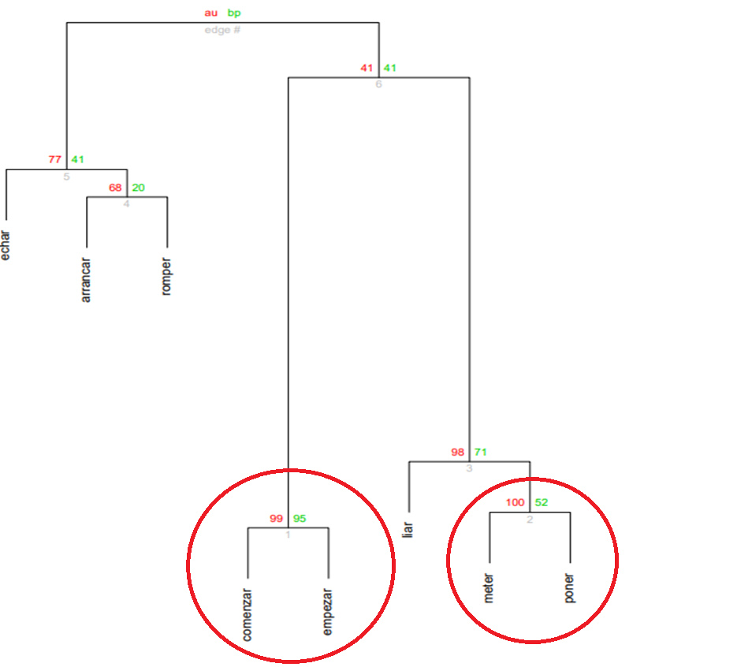
6. Hierarchical Cluster Analysis (4)

Slide 31
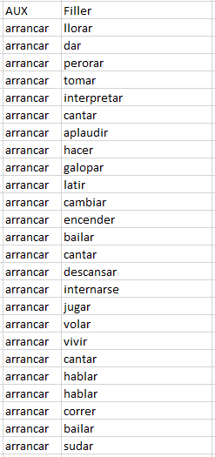
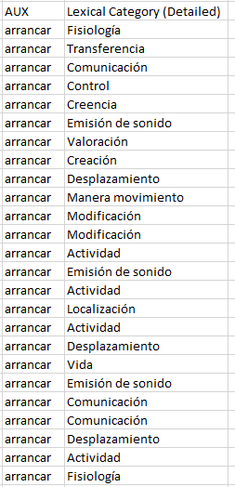
Clustering based on lexical categories
Based on the lexical classification of ADESSE

Slide 32
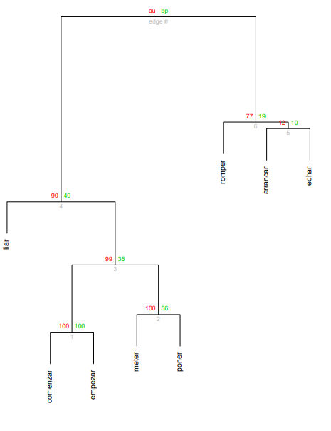
6. Hierarchical Cluster Analysis (5)

Slide 33
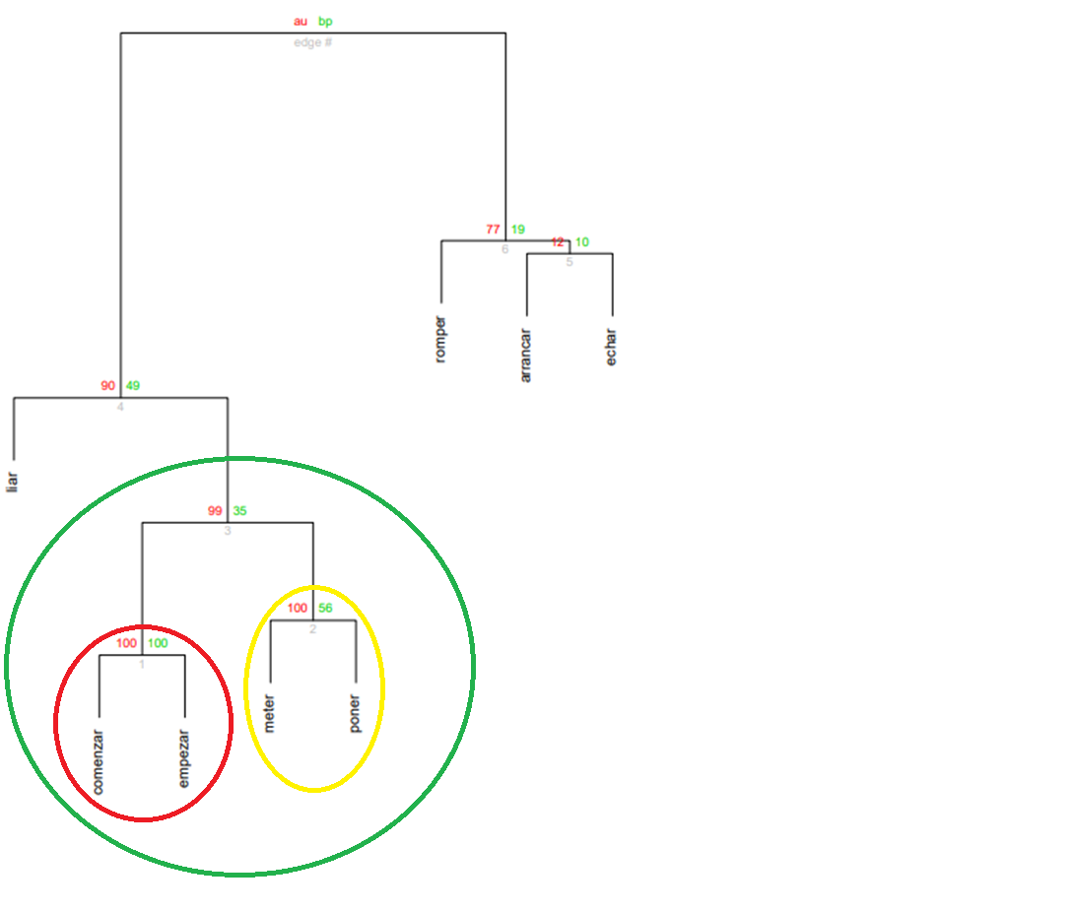
6. Hierarchical Cluster Analysis (6)

Slide 34
0. Revision of the concept of productivity
1. Introduction: The inchoative construction in Spanish
2. Research Questions
3. Methodology
4. Cleaning Process
5. Data Exploration
6. Hierarchical Cluster Analysis
7. Near Future

Slide 35
7. In the near future
Vector Space Semantics
Psycholinguistic experiments
Acceptability judgement
Eye-tracking
EEG ?
Diachronic corpus study

Slide 36
Thank you for your attention!
Bedankt voor uw aandacht!

